Slide 1

Introduction to Graph Neural Networks and Case Analysis

Slide 2

CONTENTS
01
Introduction to Graph Neural Networks
02
How to train a GNN model
03
Case Studies of Graph Neural Networks
04
Analysis and Evaluation of Graph Neural Networks
05
GNN for NLP
06
Future Trends and Developments
07
Conclusion

Slide 3


01
Introduction to Graph Neural Networks

Slide 4
Definition and Basic Concepts
Definition of Graph Neural Networks
Key Components of GNNs
Advantages of GNNs
Graph Neural Networks (GNNs) are neural networks designed to operate on graph-structured data. They generalize traditional neural networks to handle data represented as graphs, where nodes represent entities and edges represent relationships between them. This allows GNNs to capture complex dependencies and interactions in the data.
The key components of GNNs include nodes, edges, and the graph structure itself. Nodes can have features, and edges can have weights or types. The graph structure defines how information is propagated between nodes. GNNs use message passing mechanisms to aggregate information from neighboring nodes and update node representations.
GNNs offer several advantages over traditional neural networks. They can handle irregular data structures, capture long-range dependencies, and are highly expressive. These properties make GNNs suitable for a wide range of applications, including social network analysis, molecular chemistry, and recommendation systems.

Slide 5
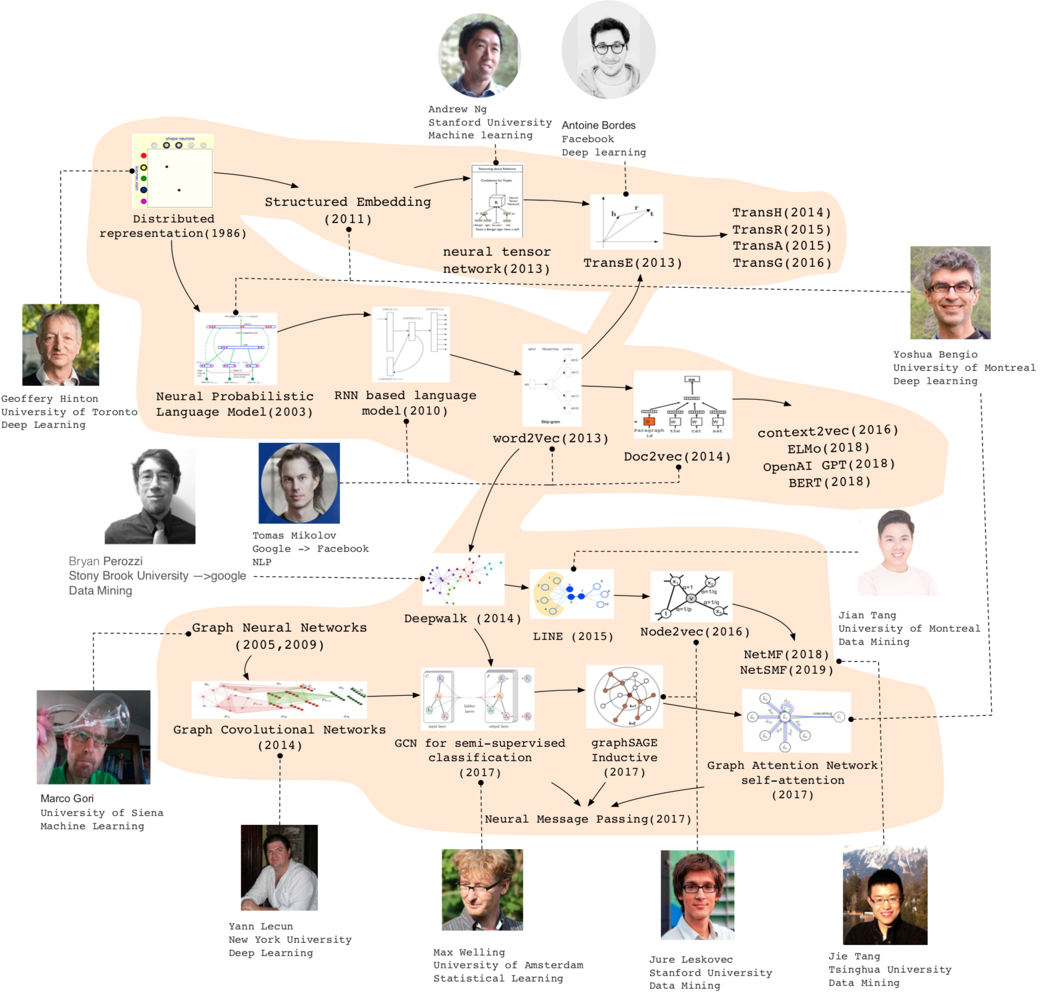
History of Graph Representation Learning

Slide 6
Types of Graph Neural Networks
Graph Convolutional Networks (GCNs)
Graph Convolutional Networks (GCNs) are a popular type of GNN. They perform convolution operations on graph data by aggregating features from neighboring nodes. GCNs use spectral graph theory and can be applied to tasks such as node classification and graph classification. They are effective in capturing local neighborhood information.
Graph Attention Networks (GATs)
Graph Attention Networks (GATs) introduce attention mechanisms to GNNs. They allow each node to assign different importance weights to its neighbors, enabling more flexible and adaptive information aggregation. GATs are particularly useful in scenarios where the importance of different neighbors varies significantly.
GraphSAGE
GraphSAGE is a framework for inductive representation learning on graphs. It aims to generate node embeddings for previously unseen nodes or graphs, which is crucial for real-world applications where the graph structure can change over time or new nodes are added.

Slide 7



Applications of Graph Neural Networks
Social Network Analysis
Recommendation Systems
Molecular Chemistry
In social network analysis, GNNs can be used for tasks such as community detection, link prediction, and influence maximization. They can model the complex relationships between users and identify patterns and structures within social networks. For example, GNNs can predict potential friendships or detect communities with similar interests.
In molecular chemistry, GNNs are applied to predict molecular properties, drug discovery, and protein structure prediction. They can represent molecules as graphs, with atoms as nodes and chemical bonds as edges. GNNs can learn the relationships between atoms and predict properties such as molecular stability and drug efficacy.
GNNs can enhance recommendation systems by modeling user-item interactions as a graph. They can capture the complex relationships between users and items, as well as the interactions between different users and items. This allows for more accurate and personalized recommendations, improving user experience and system performance.

Slide 8
02
How to train a GNN model

Slide 9
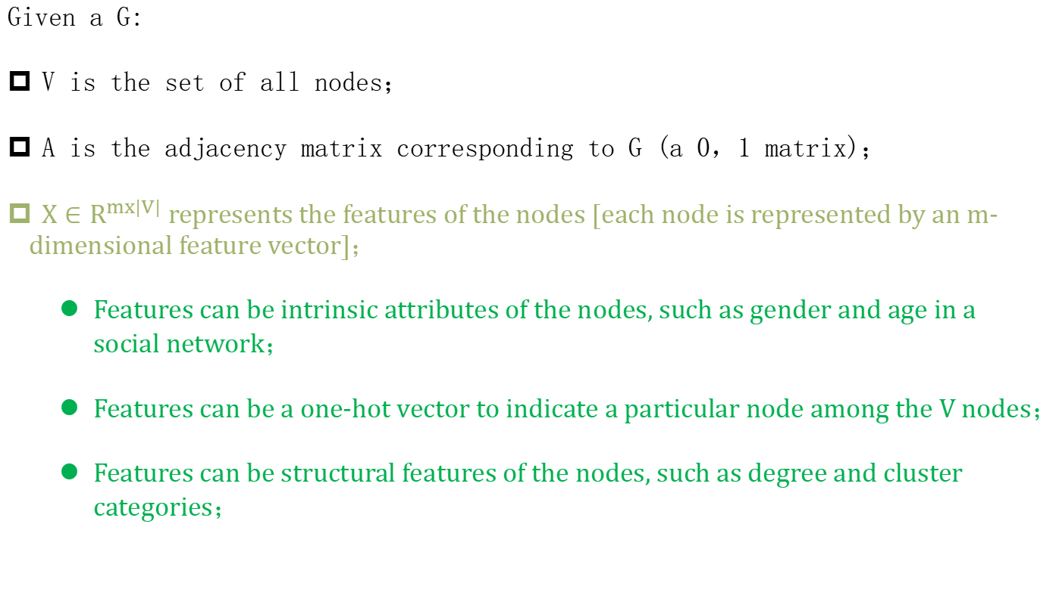
Graph Neural Network：mathematical concept
Given a G:
V is the set of all nodes；
A is the adjacency matrix corresponding to G (a 0，1 matrix)；
$X∈R^{mx|V|}$ represents the features of the nodes [each node is represented by an m-dimensional feature vector]；
Features can be intrinsic attributes of the nodes, such as gender and age in a social network；
Features can be a one-hot vector to indicate a particular node among the V nodes；
Features can be structural features of the nodes, such as degree and cluster categories；

Slide 10
Graph Neural Network：core idea
The core idea of GNN is to aggregate the neighborhood features of a target node to obtain a new expression for it

Slide 11
Graph Neural Network：core idea
The core idea of GNN is to aggregate the neighborhood features of a target node to obtain a new expression for it
An analogy to a two-layer MLP
Layer-0
Layer-1
Layer-2
node initialization features
The network can be arbitrarily deep；
It is possible to define very complex aggregation functions [such as deep neural networks]；

Slide 12
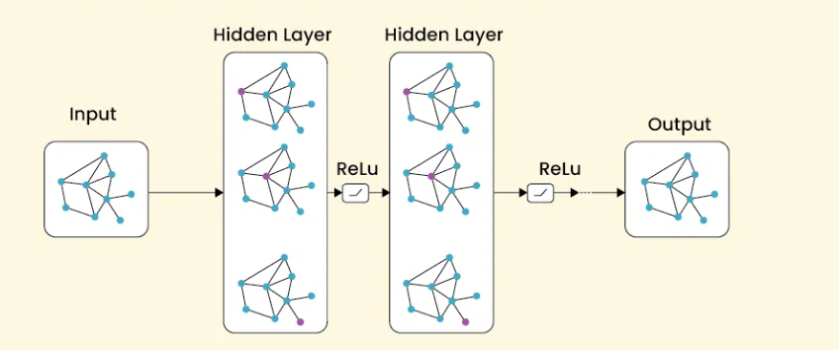
Graph Neural Network：The selection of aggregation function
Graph Convlutional Neural：The combination of avg/sum and neural networks for aggregating neighboring nodes.

Slide 13
Graph Neural Network：The selection of aggregation function
The core idea of GNN is to aggregate the neighborhood features of a target node to obtain a new expression for it
1：sum/avg
2：Neural Network

Slide 14
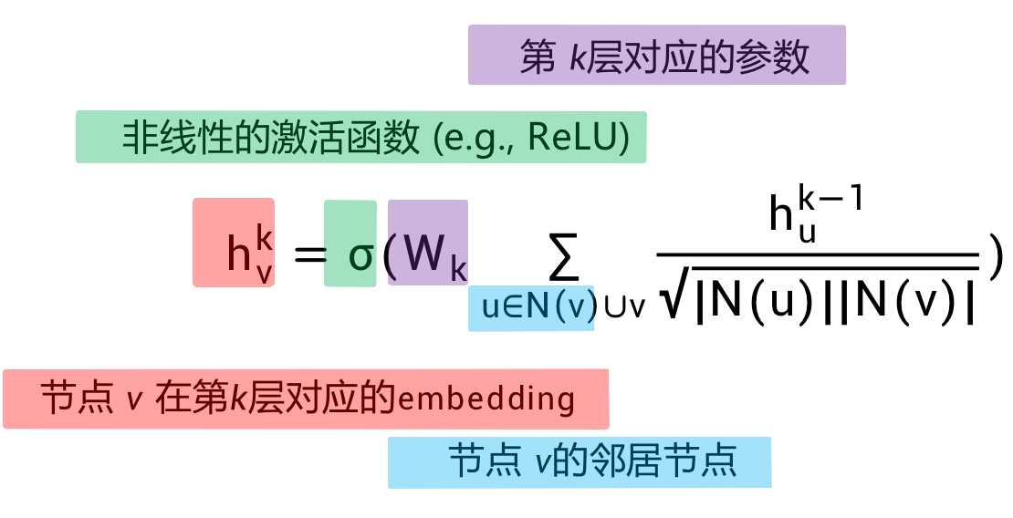
Graph Neural Network：The selection of aggregation function
Graph Convlutional Neural：The combination of avg/sum and neural networks for aggregating neighboring nodes.
Parameters corresponding to the k^{th} layer.
a
b
Nonlinear activation function (e.g., ReLU).
v
c
e
Embedding corresponding to node v at the k^{th} layer
d
Neighbors of node v
Notes:
目标节点：v 表示目标节点。
激活函数：σ 是激活函数（如 ReLU），为模型引入非线性。
权重矩阵：W k是可训练的权重矩阵，用于线性变换。
邻居节点：N(v) 表示节点 v 的邻居节点集合。
其中 ∣N(u)∣ 和 ∣N(v)∣ 分别是节点 u 和 v 的邻居节点数量，用于调整不同节点的邻居数量差异带来的影响。
聚合操作：∑ u∈N(v) 表示对节点 v 的所有邻居节点 u 进行求和，实现信息聚合

Slide 15
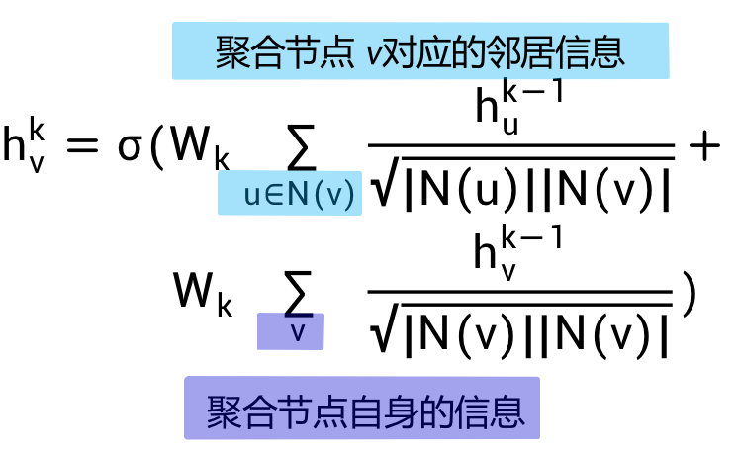
Graph Neural Network：The selection of aggregation function
Graph Convlutional Neural：The combination of avg/sum and neural networks for aggregating neighboring nodes.
Aggregate the neighbor information of node v.
a
b
v
c
e
d
Aggregate the self information of node v

Slide 16
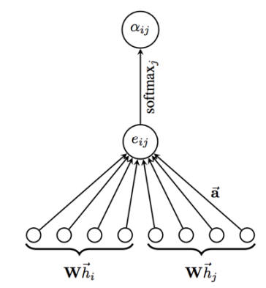
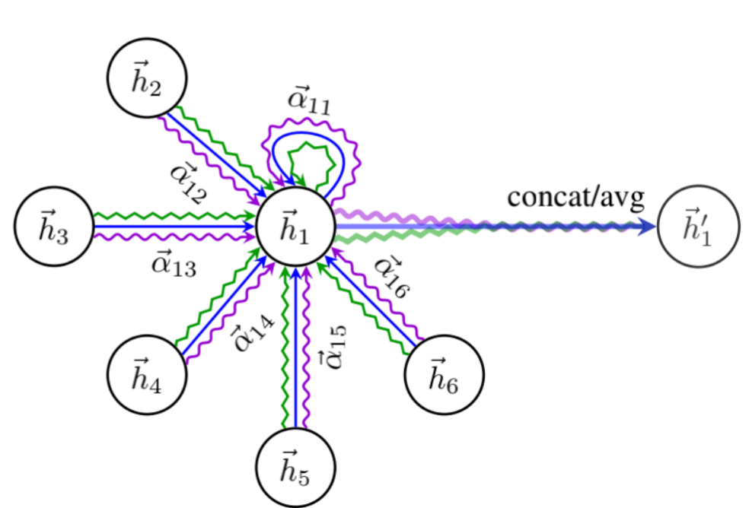
Graph Neural Network：GAT
GAT - Graph Attention Network，Aggregation based on Attention.

Slide 17
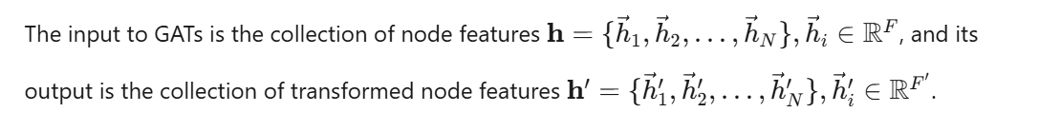
Graph Neural Network：GAT
GAT - Graph Attention Network，Aggregation based on Attention.

Slide 18




Graph Neural Network：GAT
The attention coefficients are calculated as follows
where a denotes the attention mechanism function. Normalizing the above equation yields
Here, N_{i} represents the set of neighboring nodes of node i.
The attention mechanism function can be represented by a single-layer neural network, with parameters a∈R ^{2F ′.} Then equation (2.31) can be written as:

Slide 19

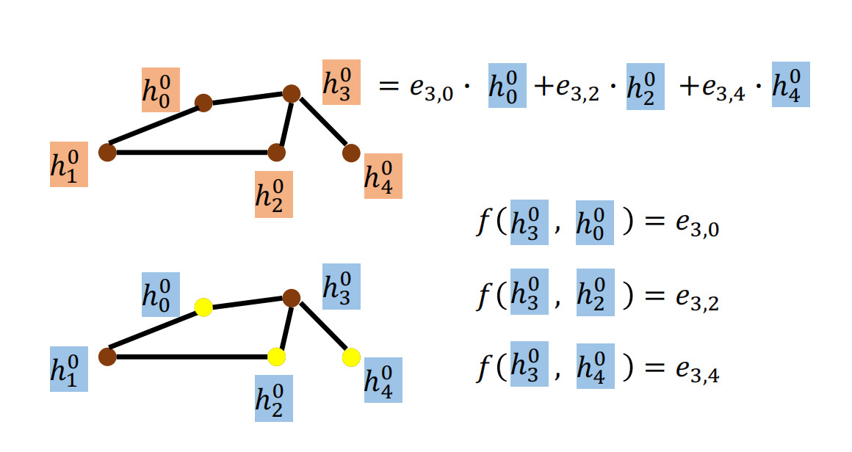
Graph Neural Network：GAT
where || denotes the concat operation. Once the attention coefficients are obtained, the output is the linear combination of the transformed features and the attention coefficients:

Slide 20
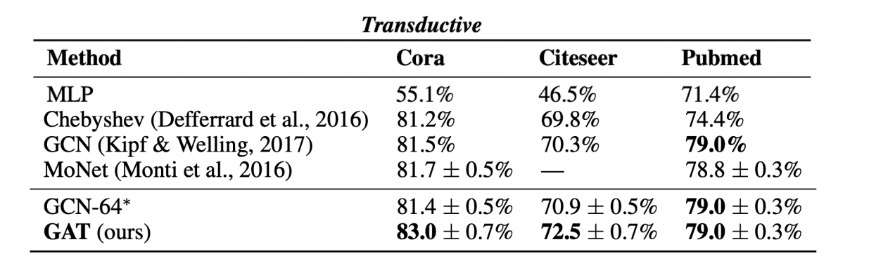
Graph Neural Network：GAT

Slide 21
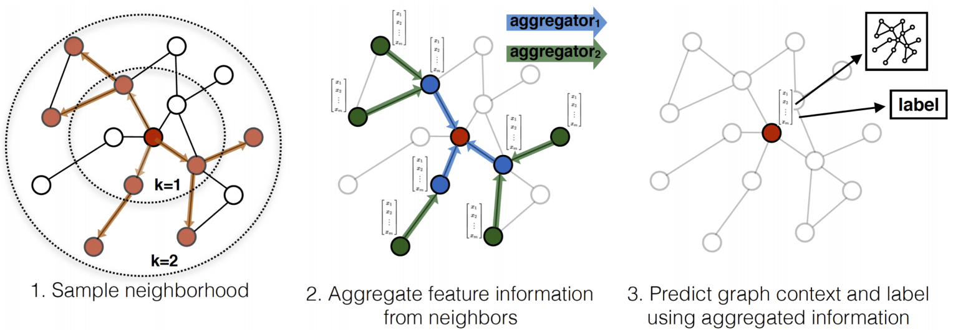
Graph Neural Network：GraphSAGE
AGGREGATION:mean,max-pooling,or LSTM

Slide 22
Graph Neural Network：GraphSAGE
AGGREGATION:mean,max-pooling,or LSTM
Sampling can speed up training on large networks (e.g., social networks).；
Forcing the model to learn combinational patterns of nodes for robustness
Effective use of multi-hop information,
with hierarchical aggregation of different types of information.
why sample？

Slide 23
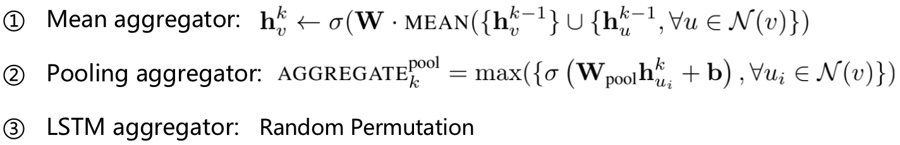
Graph Neural Network：GraphSAGE
AGGREGATION:mean,max-pooling,or LSTM
Notes:
均值聚合器：对于节点 v，它取其自身的前一层嵌入 h_{v}^{k−1}和所有邻居节点 {h_{u}^{k−1}
​ ,∀u∈N(v)} 的前一层嵌入的均值。然后，这个均值与权重矩阵 W 相乘，并通过激活函数 σ 得到新的嵌入 h_{v}^{k} 。
池化聚合器：它对邻居节点的嵌入进行池化操作。对于节点 v 的每个邻居 u _{i}
​，首先使用权重矩阵 W pool和偏置向量 b 对邻居的嵌入 h _{u i}^{k−1}进行变换，然后应用激活函数 σ。最后，对所有变换后的邻居嵌入取最大值，得到聚合后的值 AGGREGATE 。
LSTM 聚合器：它利用 LSTM 来聚合信息。以随机顺序将邻居节点的嵌入输入 LSTM，从而捕获序列信息，这有助于从邻居中学习复杂的模式

Slide 24
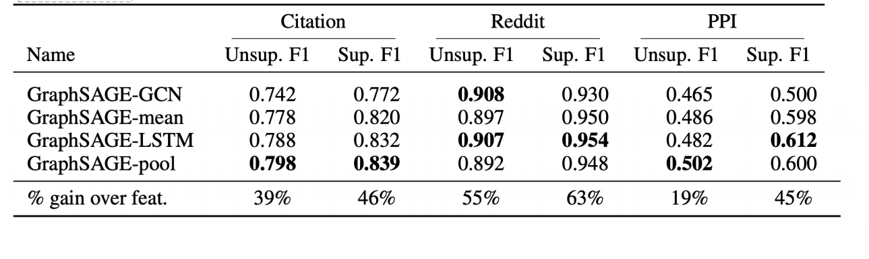
Graph Neural Network：GraphSAGE

Slide 25
03
Case Studies of Graph Neural Networks

Slide 26

Social Network Analysis Case Study
Dataset and Problem Statement
The dataset used in this case study is a large-scale social network dataset containing user interactions and social connections. The problem statement is to predict potential friendships between users based on their existing connections and interaction patterns. This can help expand the social network and improve user engagement.
Model Selection and Training
We selected a Graph Convolutional Network (GCN) for this task due to its effectiveness in capturing local neighborhood information. The GCN model was trained on the social network dataset using node features such as user profiles and interaction history. The training process involved optimizing the model parameters to minimize the prediction error.
Results and Analysis
The GCN model achieved high accuracy in predicting potential friendships. It was able to identify users with similar interests and interaction patterns, leading to accurate friendship recommendations. The results demonstrate the power of GNNs in social network analysis and their ability to capture complex relationships between users.

Slide 27

Molecular Chemistry Case Study
Dataset and Problem Statement
The dataset consists of molecular structures and their corresponding properties. The problem statement is to predict the stability of molecules based on their graph representations. This is crucial for drug discovery and material science applications, as stable molecules are more likely to be effective and safe.
Model Selection and Training
Results and Analysis
A Graph Attention Network (GAT) was chosen for this task due to its ability to assign different importance weights to neighboring atoms. The GAT model was trained on the molecular dataset using atom features and bond types. The training process involved learning the relationships between atoms and predicting molecular stability with high accuracy.
The GAT model showed excellent performance in predicting molecular stability. It was able to capture the complex interactions between atoms and identify key structural features that contribute to stability. The results highlight the potential of GNNs in molecular chemistry and their ability to model complex molecular structures.

Slide 28

Recommendation System Case Study
01
02
03
Dataset and Problem Statement
Model Selection and Training
Results and Analysis
The dataset is a user-item interaction dataset from an e-commerce platform. The problem statement is to provide personalized product recommendations to users based on their historical interactions and preferences. This can improve user satisfaction and increase sales for the platform.
A Graph Neural Network-based recommendation model was developed. The model represented users and items as nodes in a graph and used user-item interactions as edges. The model was trained using collaborative filtering techniques and node features such as user profiles and item attributes. The training process involved optimizing the model to minimize the recommendation error.
The GNN-based recommendation model outperformed traditional recommendation algorithms. It was able to capture the complex relationships between users and items, leading to more accurate and personalized recommendations. The results demonstrate the effectiveness of GNNs in recommendation systems and their ability to model user-item interactions.

Slide 29
YOUR LOGO
04
Analysis and Evaluation of Graph Neural Networks

Slide 30
Performance Metrics
Accuracy and Precision
Accuracy measures the proportion of correctly predicted instances out of all predictions. Precision focuses on the proportion of true positives among all positive predictions. These metrics are commonly used to evaluate the performance of GNNs in classification tasks, such as node classification and graph classification.
Recall and F1 Score
Mean Squared Error (MSE)
Recall measures the proportion of true positives among all actual positives. The F1 score is the harmonic mean of precision and recall, providing a balanced measure of model performance. These metrics are important for evaluating the completeness of predictions and are particularly useful in imbalanced datasets.
Mean Squared Error (MSE) is used to evaluate the performance of GNNs in regression tasks, such as predicting molecular properties or time-series values. It measures the average squared difference between predicted and actual values, providing a quantitative measure of prediction accuracy.

Slide 31
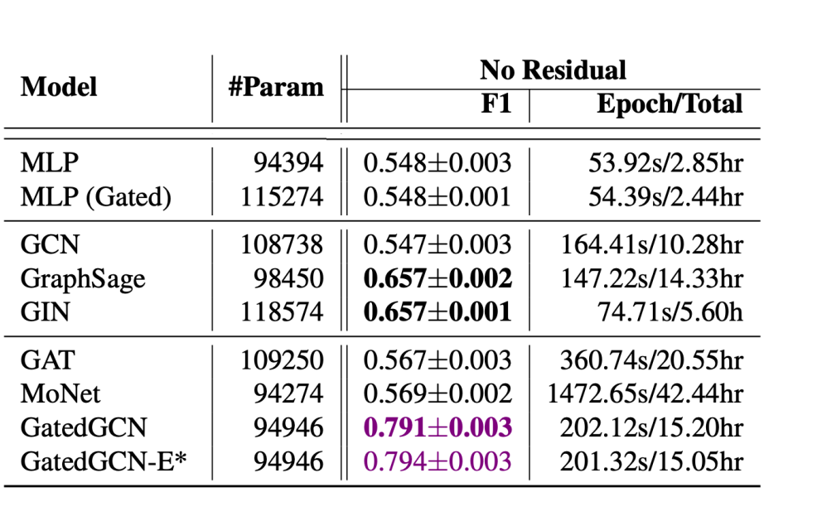
Performance Metrics

Slide 32

Evaluation Methods
01
Cross-Validation
Cross-validation is a widely used evaluation method for GNNs. It involves splitting the dataset into multiple folds and training the model on different subsets while validating on the remaining data. This helps assess the model's generalization ability and provides a more reliable performance estimate.
02
Train-Test Split
Train-test split is another common evaluation method. The dataset is divided into training and testing sets, with the model trained on the training set and evaluated on the testing set. This method provides a straightforward way to assess the model's performance on unseen data.
Ablation Studies
03
Ablation studies involve removing or modifying certain components of the GNN model to understand their impact on performance. This helps identify the key factors contributing to the model's effectiveness and provides insights into model design and optimization.

Slide 33
Challenges and Limitations
Scalability
One of the main challenges of GNNs is scalability. As the size of the graph increases, the computational complexity and memory requirements of GNNs can become prohibitive. This limits their application to large-scale datasets and requires the development of more efficient algorithms and techniques.
Overfitting
GNNs are prone to overfitting, especially when the graph structure is complex or the dataset is small. Overfitting occurs when the model learns to fit the training data too closely, resulting in poor generalization to unseen data. Regularization techniques and data augmentation methods are often used to address this issue.
Interpretability
Another limitation of GNNs is their lack of interpretability. The complex interactions and dependencies captured by GNNs can make it difficult to understand the reasoning behind their predictions. Developing interpretable GNN models is an active area of research, aiming to provide insights into the decision-making process.

Slide 34
05
GNN for NLP

Slide 35
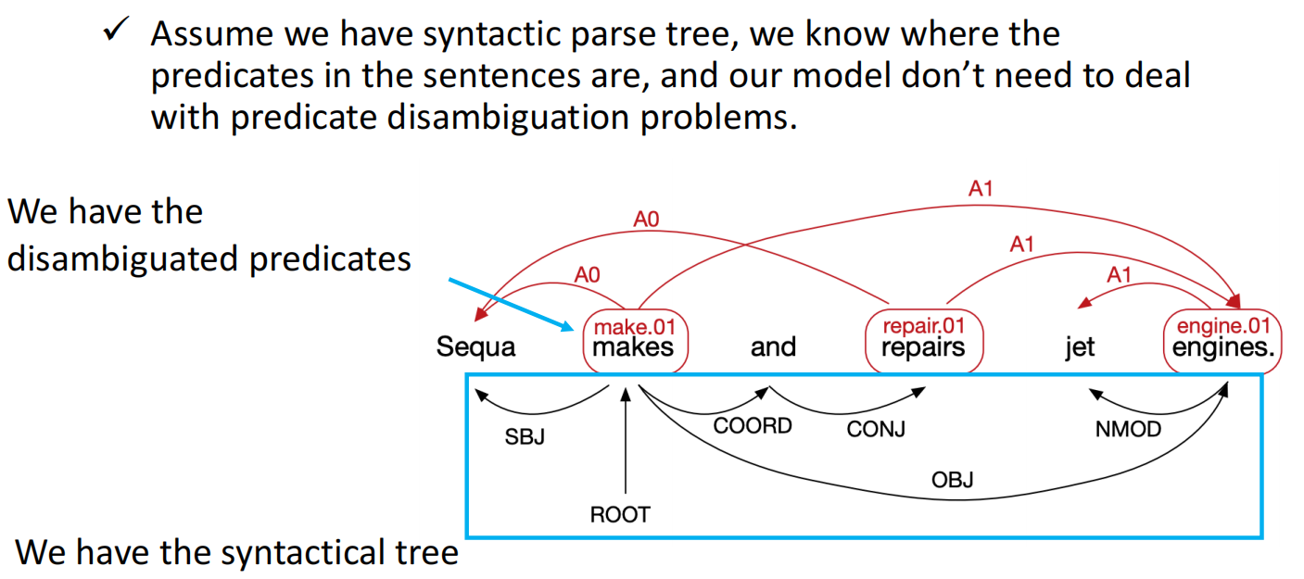
GCN for Semantic Roles Labeling

Slide 36
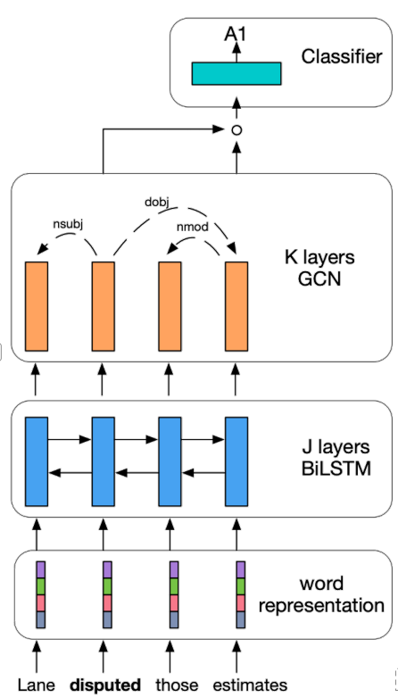
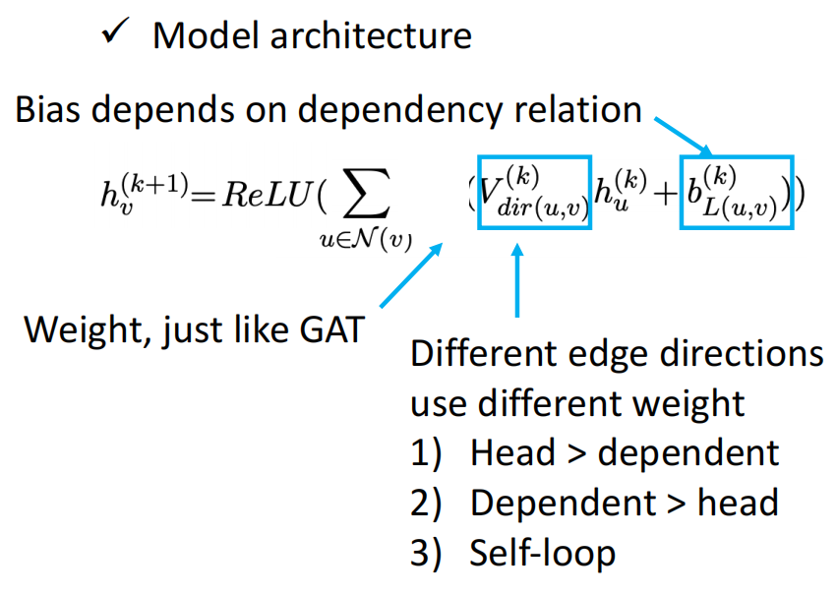
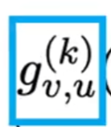
GCN for Semantic Roles Labeling

Slide 37
06
Future Trends and Developments

Slide 38
Research Directions
01
Graph Neural Network Architectures
Future research will focus on developing more advanced and efficient GNN architectures. This includes exploring new types of GNNs, such as hierarchical GNNs and multi-scale GNNs, to capture more complex graph structures and relationships. The goal is to improve the performance and scalability of GNNs for various applications.
02
Graph Representation Learning
Graph representation learning is an important research direction. It involves learning meaningful and compact representations of graphs that can be used for various downstream tasks. Techniques such as graph embeddings and graph autoencoders will be further developed to improve the quality and interpretability of graph representations.
Applications and Domains
03
GNNs will continue to be applied to new domains and applications. This includes areas such as healthcare, finance, and natural language processing. For example, GNNs can be used for disease prediction, fraud detection, and text classification. The development of domain-specific GNN models and techniques will be a key focus.

Slide 39
Practical Considerations
Implementation and Tools
Practical implementation of GNNs requires efficient and user-friendly tools and frameworks. Popular deep learning frameworks such as PyTorch and TensorFlow have started to support GNN operations. Future developments will focus on improving the ease of use and performance of these tools, making GNNs more accessible to researchers and practitioners.
Data Collection and Preprocessing
Data collection and preprocessing are crucial for the success of GNN applications. High-quality and representative datasets are needed to train effective GNN models. Future work will involve developing better data collection methods and preprocessing techniques to handle the unique challenges of graph data, such as noise and missing values.
Deployment and Integration
Deploying GNN models in real-world applications requires seamless integration with existing systems and workflows. This involves addressing issues such as model deployment, inference speed, and compatibility with other technologies. Future developments will focus on making GNNs more deployable and integrable, enabling their widespread adoption.

Slide 40
07
Conclusion

Slide 41
Summary of Key Points
Overview of Graph Neural Networks
Graph Neural Networks (GNNs) are powerful tools for modeling graph-structured data. They can capture complex relationships and dependencies in the data, making them suitable for a wide range of applications.
Case Studies and Applications
Analysis and Future Trends
Through case studies in social network analysis, molecular chemistry, and recommendation systems, we demonstrated the effectiveness of GNNs in solving real-world problems. GNNs achieved high performance in tasks such as friendship prediction, molecular stability prediction, and personalized recommendations.
We analyzed the performance metrics, evaluation methods, and challenges of GNNs. Future trends include the development of advanced GNN architectures, graph representation learning techniques, and applications in new domains. Practical considerations such as implementation tools, data preprocessing, and deployment will also be important.

Slide 42
Future Work and Recommendations
01
Research and Development
Future work should focus on addressing the challenges of GNNs, such as scalability, overfitting, and interpretability. Developing more efficient algorithms, regularization techniques, and interpretable models will be crucial for the advancement of GNN research.
02
Practical Applications
In practical applications, it is important to carefully select and preprocess the data, choose appropriate GNN models, and evaluate their performance rigorously. Collaboration between researchers and practitioners will help bridge the gap between theoretical research and real-world applications.
Community and Collaboration
03
Building a strong community and fostering collaboration among researchers, developers, and practitioners will be essential for the growth and development of GNNs. Sharing knowledge, resources, and best practices will accelerate the progress and adoption of GNNs in various fields.

Slide 43
THANK YOU

